Slide 1
ESc201 : Introduction to Electronics
Digital Circuits: Decoders
Vipul Arora
Dept. of Electrical Engineering
IIT Kanpur
Apr 5, 2023

Slide 2
Design Flow
System Description
Truth Table
Boolean Expression
Minimized
Boolean Expression
This design approach becomes difficult to use
Gate Netlist

Slide 3
General Approach
Sub-Sub-system-1
Sub-system-1
Sub-system-3
System
Sub-system-2
There are certain sub-systems or blocks that are used quite often such as :
Decoders, Encoders
Multiplexers
Adder/Subtractors, Multipliers
Comparators
Parity Generators
……..

Slide 4
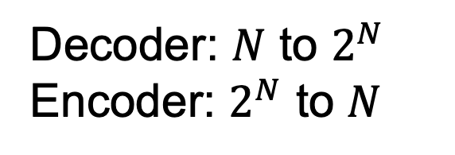
Decoders
Small to large size
Maps a binary number to one-hot representation
Decoder: $N$ to $2^{N}$
Encoder: $2^{N}$ to $N$

Slide 5
Example

Slide 6



Decoder with Enable Input

Slide 7
Decoder: gate Implementation

Slide 8
A n to 2^{n} decoder is a minterm generator
It can be used to implement any combinational circuit
0
1
0
0
1
1
0

Slide 9
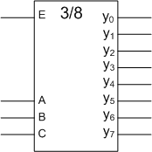

Implementation of a 3-variable function with a 3-to-8 decoder
1
1
0
1
0
0
0
0
0
0
0
0
0
Although it is easy to implement any combinational circuit with this method , it is often very inefficient in terms of gate utilization. Note that this method does not require any minimization.

Slide 10
3/8 decoder using 2/4 decoders
0
1
1
1
0
1
0
0
0
0
0
0
0
0
How many 2/4 decoders are required to implement a 4/16 decoder ?

